Slide 1
DevSecOps Course
Primary Instructor: CW2 Sean Herbert
Alternate Instructor: CW3 Nick Chadwick

Slide 2
Instructor Background
How you got started in DevSecOps.
What are you currently doing now.

Slide 3
Why Learn This?
75th Innovation Command is receiving an increased demand to support these kinds of missions.
Significant salary increases – 25% or more.
Anyone who works with software can incorporate DevSecOps within their current organization.
Application containerization.
Automate tasks.
Ensure proper security compliance is being enforced.

Slide 4
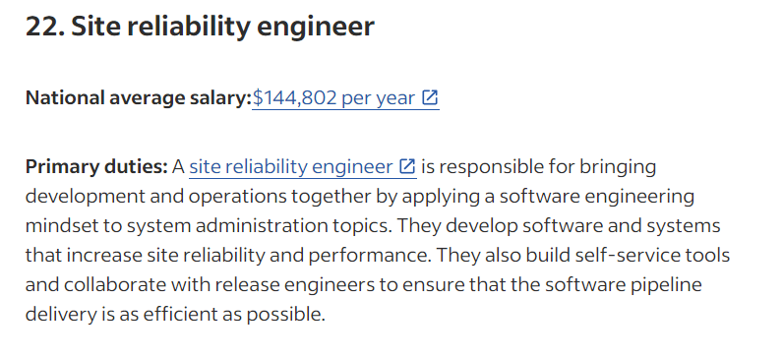
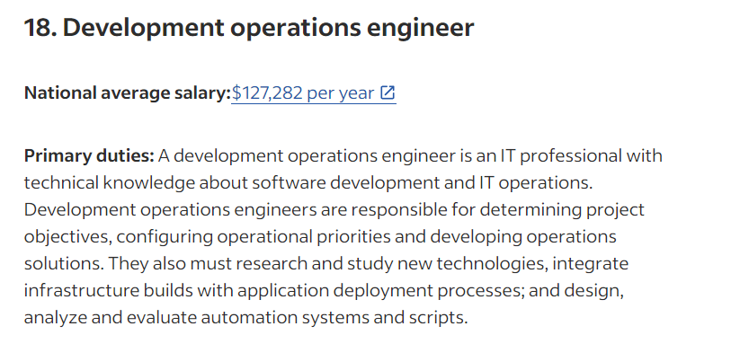
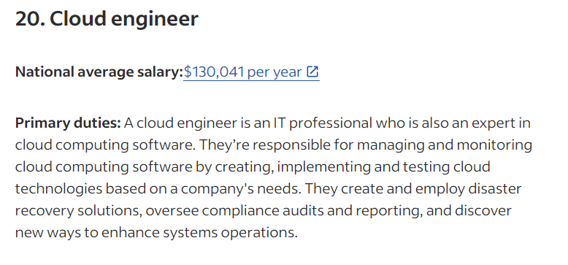
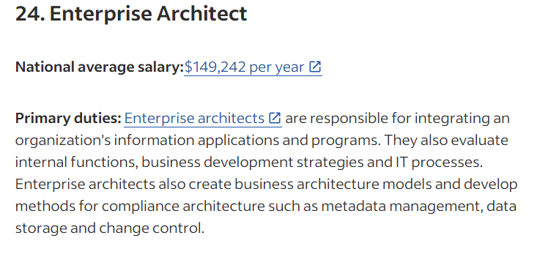
Why become a DevSecOps Engineer?
https://www.indeed.com/career-advice/finding-a-job/top-paying-technology-jobs
Common technical job titles
DevOps Engineer
Cloud Engineer
Site Reliability Engineer
Common technical management job titles
Technical Lead
Architect

Slide 5
What is DevSecOps?
“DevSecOps is a software engineering culture and practice that aims at unifying software development (Dev), security (Sec), and operations (Ops). DevSecOps emphasizes collaboration and communication between development, security, and operations teams to deliver secure and resilient software at the speed of relevance. It involves automating security and testing processes, integrating security tools and practices into the development pipeline, and fostering a culture of shared responsibility for performance and security.” https://www.cloud.mil/devsecops/

Slide 6
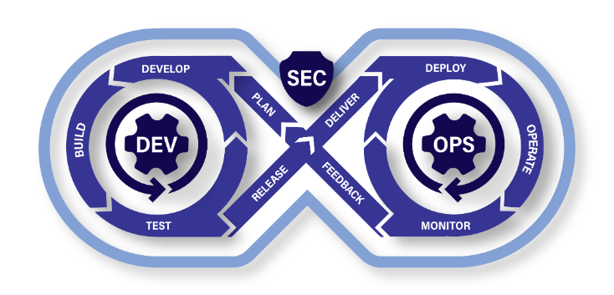
Continuous Integration/ Continuous Deployment (CI/CD)

Slide 7
Key Tools that Enables DevSecOps
Infrastructure as Code (IaC)
“Infrastructure as code (IaC) is the ability to provision and support your computing infrastructure using code instead of manual processes and settings.” https://aws.amazon.com/what-is/iac/
Containerization
“Containerization is a software deployment process that bundles an application’s code with all the files and libraries it needs to run on any infrastructure.” https://aws.amazon.com/what-is/containerization/
Continuous Integration/ Continuous Deployment (CI/CD)
“CI/CD falls under DevOps (the joining of development and operations teams) and combines the practices of continuous integration and continuous delivery. CI/CD automates much or all of the manual human intervention traditionally needed to get new code from a commit into production, encompassing the build, test (including integration tests, unit tests, and regression tests), and deploy phases, as well as infrastructure provisioning.” https://about.gitlab.com/topics/ci-cd/

Slide 8
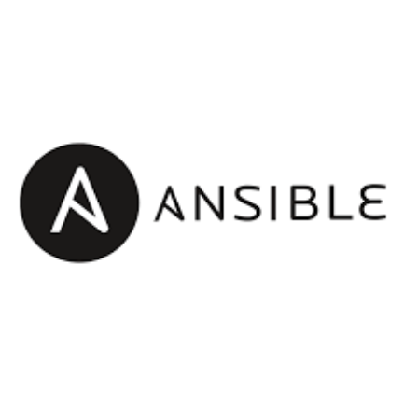
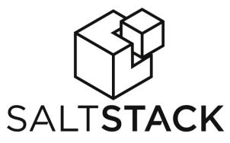

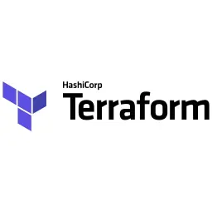
Popular IaC Tools
Persistent – Changes are permanent and remain in effect until manually modified.
Non-persistent – Changes can be automatically reverted or overwritten by IaC tools.

Slide 9
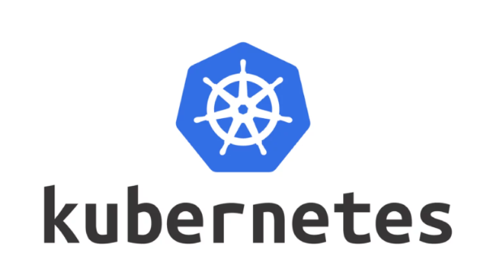
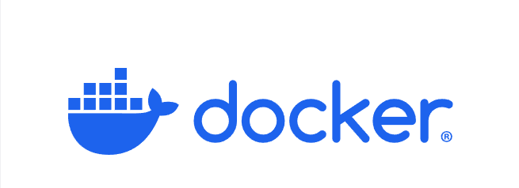
Popular Containerization Tools

Slide 10
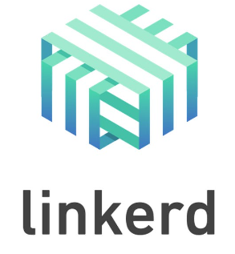
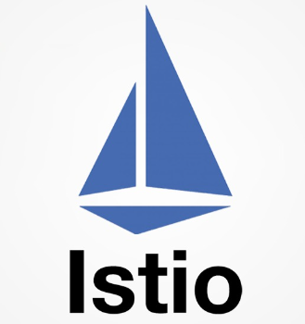
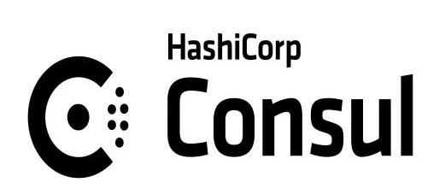
Popular Service Mesh Tools

Slide 11

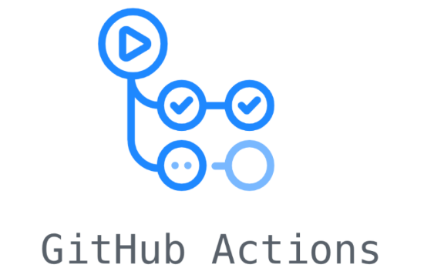

Popular CI/CD Tools

Slide 12
Common Security Vulnerability Tests
Secrets Scanning
Static Analysis Software Test (SAST)
Dynamic Analysis Software Test (DAST)
Container Software Bill of Material (SBOMs)

Slide 13
What is DevSecOps trying to enable?
DevSecOps Platform
Software Factory
Continuous Authority to Operate (cATO)

Slide 14
Overall Benefit
Consistent, repeatable outcomes in testing, vulnerability assessments, and deployments across development, staging, and production environments—enabled by automation.
Collaborative responsibility for delivering software, with shared ownership between developers, DevSecOps engineers, and management.
Significantly accelerated time to ATO (Authority to Operate) through streamlined, automated processes.

Slide 15
More Resources
Department of Defense DevSecOps Playbook
https://dodcio.defense.gov/Portals/0/Documents/Library/DoD%20Enterprise%20DevSecOps%20Fundamentals%20v2.5.pdf
Learning DevSecOps (Don’t expect a high paying salary without investing into your education)
https://kodekloud.com/
https://engineer.kodekloud.com/
Contribute or use Cloud Native tools within your organization
https://www.cncf.io/

